Slide 1

Serverless Application with AWS
Suman Debnath

Slide 2

Serverless Computing
Serverless Architecture
Serverless Application with Python

Slide 3
Serverless Computing
Serverless Architecture
Serverless Application with Python

Slide 4

Serverless Computing
Build and run applications without thinking about servers

Slide 5


Serverless Computing
No servers to provision,
scale or manage
Flexible scaling
Built-in availability
and
fault tolerance

Slide 6

AWS Lambda
Run code without thinking about servers
Pay for only the compute time you consume
Lambda takes care of everything required to run and scale your code with high availability

Slide 7
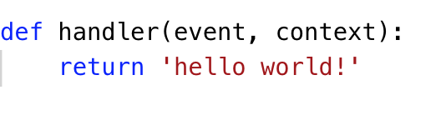
AWS Lambda Function

Slide 8
AWS Lambda Function

Slide 9
AWS Lambda Function
1
Define python function

Slide 10
AWS Lambda Function
1
Define python function
2
event - data about what triggered invocation context - runtime information about your function

Slide 11
AWS Lambda Function
1
Define python function
2
event - data about what triggered invocation context - runtime information about your function
3
Return value sent back as response

Slide 12
AWS Lambda Function
1
Define python function
2
event - data about what triggered invocation context - runtime information about your function
app.py
3
Return value sent back as response

Slide 13
AWS Lambda Function
1
Define python function
2
event - data about what triggered invocation context - runtime information about your function
app.py
3
Return value sent back as response

Slide 14
AWS Lambda Function
1
Define python function
2
event - data about what triggered invocation context - runtime information about your function
app.py
3
Return value sent back as response
$ python
>>> import app
>>> app.handler(event={}, context=None)
'hello world!'

Slide 15
AWS Lambda Function
1
Define python function
2
event - data about what triggered invocation context - runtime information about your function
app.py
3
Return value sent back as response

Slide 16
AWS Lambda Function
1
Define python function
2
event - data about what triggered invocation context - runtime information about your function
app.py
3
Return value sent back as response
$ pip install awscli

Slide 17
AWS Lambda Function
1
Define python function
2
event - data about what triggered invocation context - runtime information about your function
app.py
3
Return value sent back as response
$ pip install awscli
$ aws config

Slide 18
AWS Lambda Function
1
Define python function
2
event - data about what triggered invocation context - runtime information about your function
app.py
3
Return value sent back as response

Slide 19
AWS Lambda Function
1
Define python function
2
event - data about what triggered invocation context - runtime information about your function
app.py
3
Return value sent back as response
$ aws lambda create-function
--function-name hello
--handler app.handler
--runtime python3.6
--role arn:aws:iam::635100884080:role/MyApp
--zip "fileb://./app.zip"

Slide 20
AWS Lambda Function
1
Define python function
2
event - data about what triggered invocation context - runtime information about your function
app.py
3
Return value sent back as response
$ aws lambda create-function
--function-name hello
--handler app.handler
--runtime python3.6
--role arn:aws:iam::635100884080:role/MyApp
--zip "fileb://./app.zip”
$ aws lambda invoke --function-name hello output

Slide 21
AWS Lambda Function
1
Define python function
2
event - data about what triggered invocation context - runtime information about your function
app.py
3
Return value sent back as response
$ aws lambda create-function
--function-name hello
--handler app.handler
--runtime python3.6
--role arn:aws:iam::635100884080:role/MyApp
--zip "fileb://./app.zip”
$ aws lambda invoke --function-name hello output
$ cat output
hello world!

Slide 22
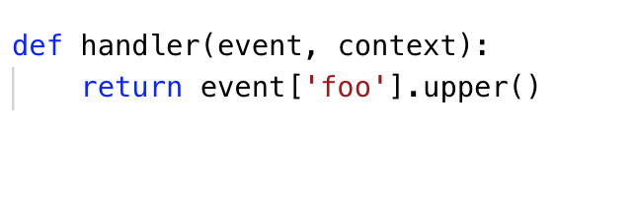
AWS Lambda Function Input
app.py

Slide 23
AWS Lambda Function Input
app.py
$ aws lambda invoke --function-name hello --payload ‘{“foo": ”bar"}' output

Slide 24
AWS Lambda Function Input
app.py
$ aws lambda invoke --function-name hello --payload ‘{“foo": ”bar"}' output

Slide 25
AWS Lambda Function Input
app.py
$ aws lambda invoke --function-name hello --payload ‘{“foo": ”bar"}' output
$ cat output
BAR

Slide 26
AWS Lambda Function Input
app.py
$ aws lambda invoke --function-name hello --payload ‘{“foo": ”bar"}' output
$ cat output
BAR
$ aws lambda invoke --function-name hello --payload ‘{“foo": ”baz"}' output

Slide 27
AWS Lambda Function Input
app.py
$ aws lambda invoke --function-name hello --payload ‘{“foo": ”bar"}' output
$ cat output
BAR
$ aws lambda invoke --function-name hello --payload ‘{“foo": ”baz"}' output
$ cat output
BAZ

Slide 28
AWS Lambda Function Invocation

Slide 29
AWS Lambda Function Invocation
$ aws lambda invoke --function-name hello --payload ‘{“foo": ”bar"}' output

Slide 30
AWS Lambda Function Invocation
$ aws lambda invoke --function-name hello --payload ‘{“foo": ”bar"}' output
Download Code

Slide 31
AWS Lambda Function Invocation
$ aws lambda invoke --function-name hello --payload ‘{“foo": ”bar"}' output
Download Code
Start new container

Slide 32
AWS Lambda Function Invocation
$ aws lambda invoke --function-name hello --payload ‘{“foo": ”bar"}' output
Download Code
Start new container
Bootstrap the runtime

Slide 33
AWS Lambda Function Invocation
$ aws lambda invoke --function-name hello --payload ‘{“foo": ”bar"}' output
Download Code
Start new container
Bootstrap the runtime
Start Code

Slide 34
AWS Lambda Function Invocation
$ aws lambda invoke --function-name hello --payload ‘{“foo": ”bar"}' output
Download Code
Start new container
Bootstrap the runtime
Start Code
Cold Start

Slide 35
AWS Lambda Function Invocation
$ aws lambda invoke --function-name hello --payload ‘{“foo": ”bar"}' output
Download Code
Start new container
Bootstrap the runtime
Start Code
Cold Start
Warm Start

Slide 36
AWS Lambda Function Invocation
$ aws lambda invoke --function-name hello --payload ‘{“foo": ”bar"}' output
Download Code
Start new container
Bootstrap the runtime
Start Code
Cold Start
Warm Start
$ aws lambda invoke --function-name hello --payload ‘{“foo": ”baz"}' output

Slide 37
Serverless Computing
Serverless Architecture
Serverless Application with Python

Slide 38
Serverless Architecture Patterns

Slide 39





Serverless Architecture
Event Trigger
Lambda
Services
Amazon API Gateway
Amazon DynamoDB
Timer
SQS message
Amazon S3

Slide 40
Serverless Architecture
Event Trigger
Lambda
Services
Amazon API Gateway
Amazon DynamoDB
Timer
Think in terms of events
SQS message
Amazon S3

Slide 41
Serverless Architecture
Event Trigger
Lambda
Services
Amazon API Gateway
Amazon DynamoDB
Timer
SQS message
Amazon S3

Slide 42
Serverless Architecture
Event Trigger
Lambda
Services
Amazon API Gateway
Amazon DynamoDB
Timer
SQS message
Amazon S3
Decompose code into separate functions

Slide 43
Synchronous Invocation
Event Trigger
Lambda
Manual Invocation
$ aws lambda invoke

Slide 44
Synchronous Invocation
Event Trigger
Lambda
GET /users
REST API Request
{“http”: “response”}

Slide 45
Async Invocation
Event Trigger
Lambda
Services

Slide 46
Async Invocation
Event Trigger
Lambda
Services
1
Amazon S3
Object upload

Slide 47
Async Invocation
Event Trigger
Lambda
Services
1
Amazon S3
Object upload
2
Return immediately

Slide 48
Async Invocation
Event Trigger
Lambda
Services
1
Amazon S3
Object upload
2
3
Event trigger notification
Return immediately

Slide 49
Async Invocation
Event Trigger
Lambda
Services
1
Amazon S3
Object upload
4
Generates thumbnail
2
3
Event trigger notification
Return immediately

Slide 50
Async Invocation
Event Trigger
Lambda
Services
1
Amazon S3
Object upload
4
Generates thumbnail
2
3
Event trigger notification
Return immediately
5
Uploads to output bucket
Upload complete

Slide 51
Stream/Poll Invocation
Event Trigger
Lambda Poller
Lambda

Slide 52
Stream/Poll Invocation
Event Trigger
Lambda Poller
Lambda
1
Amazon SQS
message added
2
Return immediately

Slide 53
Stream/Poll Invocation
Event Trigger
Lambda Poller
Lambda
1
Amazon SQS
message added
2
3
Poll for messages
Return immediately

Slide 54
Stream/Poll Invocation
Event Trigger
Lambda Poller
Lambda
1
Amazon SQS
message added
2
3
Poll for messages
Return immediately
4
Message batch

Slide 55
Stream/Poll Invocation
Event Trigger
Lambda Poller
Lambda
1
Amazon SQS
message added
2
3
Poll for messages
Return immediately
4
Message batch
5
Lambda function invoked

Slide 56
Stream/Poll Invocation
Event Trigger
Lambda Poller
Lambda
1
Amazon SQS
message added
2
3
Poll for messages
Return immediately
4
Message batch
5
Lambda function invoked
Function execution finished

Slide 57
Synchronous
Asynchronous
Stream
Blocks until response is returned from Lambda function
Lambda function triggered in response to an event, decoupled from event trigger
Lambda service polls for changes on a stream, invokes Lambda function with batch of messages

Slide 58
Synchronous
Asynchronous
Stream
Blocks until response is returned from Lambda function
Lambda function triggered in response to an event, decoupled from event trigger
Lambda service polls for changes on a stream, invokes Lambda function with batch of messages
$ aws lambda invoke
Amazon API Gateway
request
/users

Slide 59

Synchronous
Asynchronous
Stream
Blocks until response is returned from Lambda function
Lambda function triggered in response to an event, decoupled from event trigger
Lambda service polls for changes on a stream, invokes Lambda function with batch of messages
$ aws lambda invoke
Timer
Amazon API Gateway
request
/users
Amazon S3 Object
Amazon SNS Topic

Slide 60


Synchronous
Asynchronous
Stream
Blocks until response is returned from Lambda function
Lambda function triggered in response to an event, decoupled from event trigger
Lambda service polls for changes on a stream, invokes Lambda function with batch of messages
$ aws lambda invoke
Timer
Amazon SQS Message
Amazon API Gateway
request
/users
Amazon S3 Object
Amazon DynamoDB Stream
Amazon SNS Topic
Amazon Kinesis Stream

Slide 61
Serverless Computing
Serverless Architecture
Serverless Application with Python

Slide 62
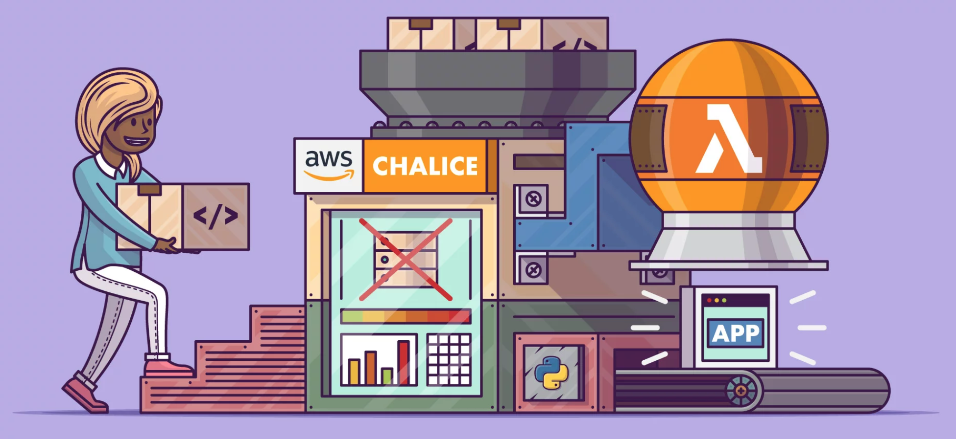
Serverless Application using Python

Slide 63
AWS Lambda

Slide 64



Setting up from scratch
AWS IAM role
IAM.put_role_policy()
IAM.create_role()
IAM policy
Lambda.create_function()
AWS Lambda
Zip of code and
dependencies

Slide 65
Setting up from scratch
AWS IAM role
IAM.put_role_policy()
IAM.create_role()
IAM policy
Lambda.create_function()
AWS Lambda
1
Zip of code and
dependencies

Slide 66
Setting up from scratch
AWS IAM role
2
IAM.put_role_policy()
IAM.create_role()
IAM policy
Lambda.create_function()
AWS Lambda
1
Zip of code and
dependencies

Slide 67
Setting up from scratch
AWS IAM role
2
IAM.put_role_policy()
IAM.create_role()
IAM policy
Lambda.create_function()
3
AWS Lambda
1
Zip of code and
dependencies

Slide 68
Creating our first Lambda Function

Slide 69
Creating our first Lambda Function
1
$ zip -r app.zip app.py

Slide 70
Creating our first Lambda Function
1
$ zip -r app.zip app.py
2
$ aws iam create-role \
--role-name MyApp \
--assume-role-policy-document '{
"Version": "2012-10-17",
"Statement": [
{
"Effect": "Allow",
"Principal": {
"Service": "lambda.amazonaws.com"
},
"Action": "sts:AssumeRole"
}
]
}'

Slide 71
Creating our first Lambda Function
1
$ zip -r app.zip app.py
3
$ aws lambda create-function \
--function-name hello \
--handler app.handler \
--runtime python3.6 \
--role arn:aws:iam::635100884080:role/MyApp \
--zip "fileb://./app.zip"
2
$ aws iam create-role \
--role-name MyApp \
--assume-role-policy-document '{
"Version": "2012-10-17",
"Statement": [
{
"Effect": "Allow",
"Principal": {
"Service": "lambda.amazonaws.com"
},
"Action": "sts:AssumeRole"
}
]
}'

Slide 72
Creating our first Lambda Function
1
$ zip -r app.zip app.py
3
$ aws lambda create-function \
--function-name hello \
--handler app.handler \
--runtime python3.6 \
--role arn:aws:iam::635100884080:role/MyApp \
--zip "fileb://./app.zip"
2
$ aws iam create-role \
--role-name MyApp \
--assume-role-policy-document '{
"Version": "2012-10-17",
"Statement": [
{
"Effect": "Allow",
"Principal": {
"Service": "lambda.amazonaws.com"
},
"Action": "sts:AssumeRole"
}
]
}'

Slide 73
Creating our first Lambda Function
1
$ zip -r app.zip app.py
3
$ aws lambda create-function \
--function-name hello \
--handler app.handler \
--runtime python3.6 \
--role arn:aws:iam::635100884080:role/MyApp \
--zip "fileb://./app.zip"
2
$ aws iam create-role \
--role-name MyApp \
--assume-role-policy-document '{
"Version": "2012-10-17",
"Statement": [
{
"Effect": "Allow",
"Principal": {
"Service": "lambda.amazonaws.com"
},
"Action": "sts:AssumeRole"
}
]
}'

Slide 74
Image Thumbnail Generator
Event Trigger
Lambda
Services
1
Amazon S3
Object upload
4
Generates thumbnail
2
3
Event trigger notification
Return immediately
5
Uploads to output bucket
Upload complete

Slide 75
Image Thumbnail Generator
AWS IAM role
IAM.put_role_policy()
IAM.create_role()
IAM policy
S3.put_bucket_notification_configuration()
Lambda.create_function()
Amazon S3
AWS Lambda
Lambda.add_permission(S3)
Notification Configuration
Zip of code and
dependencies
75

Slide 76
Image Thumbnail Generator
AWS IAM role
IAM.put_role_policy()
IAM.create_role()
IAM policy
S3.put_bucket_notification_configuration()
Lambda.create_function()
Amazon S3
AWS Lambda
1. Third party packages
2. S3 notification configuration
3. IAM Permissions
Lambda.add_permission(S3)
Notification Configuration
Zip of code and
dependencies
76

Slide 77
Image Thumbnail Generator
AWS IAM role
IAM.put_role_policy()
IAM.create_role()
IAM policy
S3.put_bucket_notification_configuration()
Lambda.create_function()
Amazon S3
AWS Lambda
1. Third party packages
2. S3 notification configuration
3. IAM Permissions
Lambda.add_permission(S3)
Notification Configuration
Zip of code and
dependencies
77

Slide 78
Image Thumbnail Generator
AWS IAM role
IAM.put_role_policy()
IAM.create_role()
IAM policy
S3.put_bucket_notification_configuration()
Lambda.create_function()
Amazon S3
AWS Lambda
1. Third party packages
2. S3 notification configuration
3. IAM Permissions
Lambda.add_permission(S3)
Notification Configuration
Zip of code and
dependencies
78

Slide 79
Image Thumbnail Generator
AWS IAM role
IAM.put_role_policy()
IAM.create_role()
IAM policy
S3.put_bucket_notification_configuration()
Lambda.create_function()
Amazon S3
AWS Lambda
1. Third party packages
2. S3 notification configuration
3. IAM Permissions
Lambda.add_permission(S3)
Notification Configuration
Zip of code and
dependencies
79

Slide 80

AWS Chailce
Python Serverless Microframework
Create and deploy serverless applications
Integration with may other AWS services

Slide 81
AWS Chalice
Lambda
handler.py
AWS Lambda

Slide 82
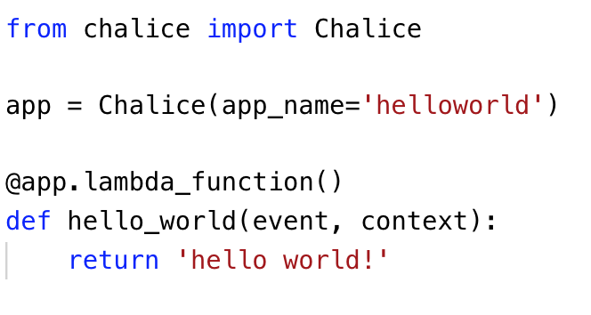
AWS Chalice
Lambda
chalice
app.py
AWS Lambda

Slide 83
AWS Chalice
Lambda
chalice
app.py
AWS Lambda
1
app defined at module level

Slide 84
AWS Chalice
Lambda
chalice
app.py
AWS Lambda
1
app defined at module level
2
one or more decorators can be defined

Slide 85
Deployment
$ chalice deploy
Creating deployment package.
Updating policy for IAM role: helloworld-dev
Creating lambda function: helloworld-dev-hello_world
Deleting Rest API: 56mbn4ke87
Deleting function: arn:aws:lambda:us-west-2:635100884080:function:helloworld-dev
Resources deployed:
- Lambda ARN: arn:aws:lambda:us-west-2:635100884080:function:helloworld-dev-hello_world
app.py
$ chalice invoke -n hello_world
"hello world!"

Slide 86
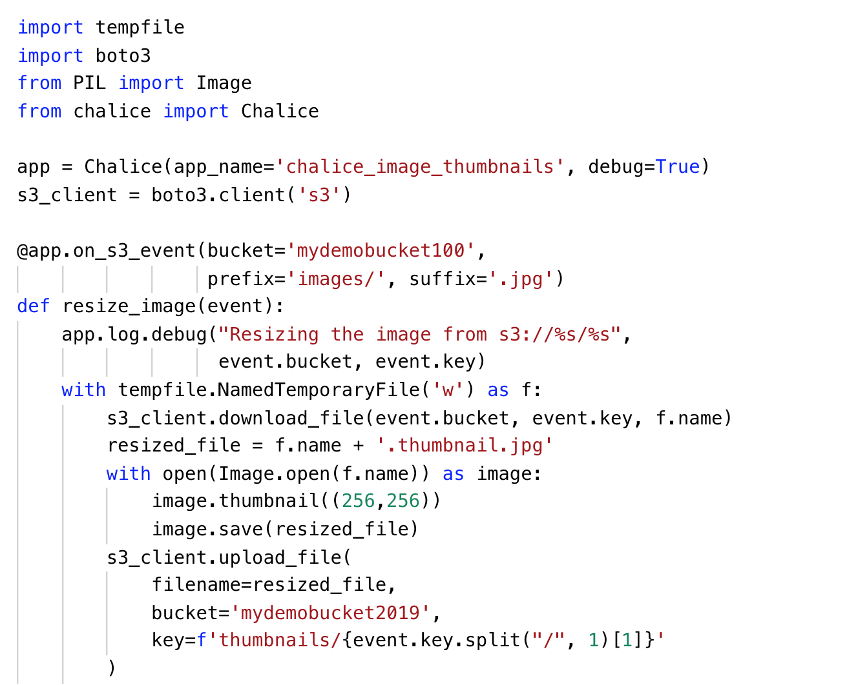
S3 Image Thumbnail Generator

Slide 87
S3 Image Thumbnail Generator
3rd party extensions automatically handled from requirements.txt

Slide 88
S3 Image Thumbnail Generator
Client created in module scope
Only part of cold-start time

Slide 89
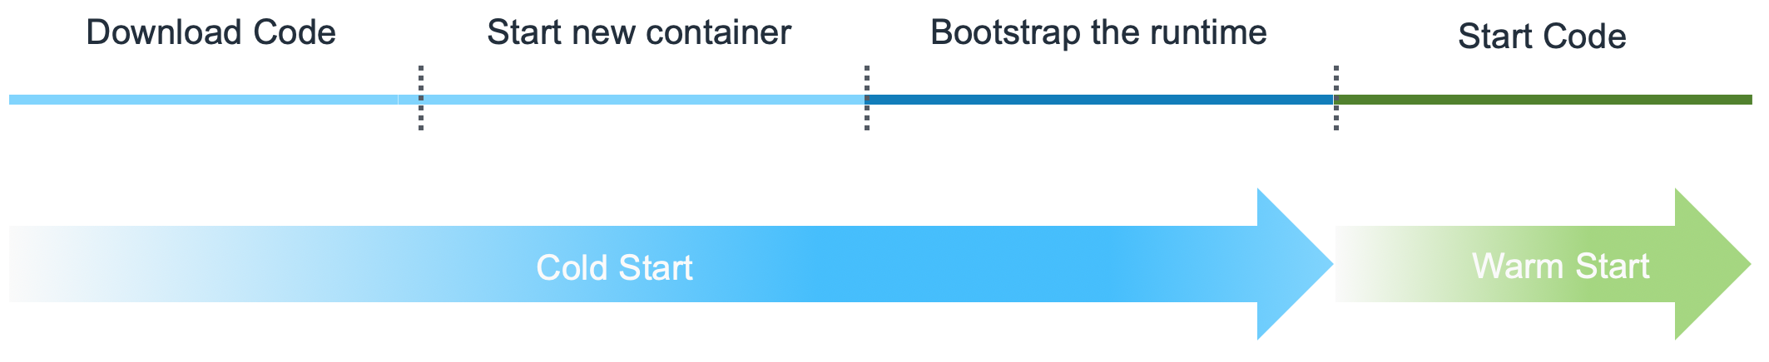
S3 Image Thumbnail Generator
Client created in module scope
Only part of cold-start time
Module Import

Slide 90
S3 Image Thumbnail Generator
Trigger function when object is uploaded to
S3://mybucket100/images/**/.jpg

Slide 91
S3 Image Thumbnail Generator

Slide 92
S3 Image Thumbnail Generator
Event dictionary mapped to python object download_file method from boto3 will download file parts in parallel

Slide 93
S3 Image Thumbnail Generator
Generate 256x256 image and save image to a temporary file

Slide 94
S3 Image Thumbnail Generator
Upload thumbnail back to S3, upload_file from boto3 will use parallelized multi part upload if needed

Slide 95



Chalice Architecture
.
├── app.py
└── requirements.txt

Slide 96
Chalice Architecture
$ chalice deploy

Slide 97
Chalice Architecture
AWS IAM role
IAM.create_role()
$ chalice deploy

Slide 98
Chalice Architecture
AWS IAM role
IAM policy
$ chalice deploy

Slide 99
Chalice Architecture
AWS IAM role
IAM.put_role_policy()
IAM policy
$ chalice deploy

Slide 100
Chalice Architecture
AWS IAM role
IAM.put_role_policy()
$ chalice deploy

Slide 101
Chalice Architecture
AWS IAM role
.
├── app.py
└── requirements.txt
$ chalice deploy

Slide 102

Chalice Architecture
Chalice runtime
AWS IAM role
deploy.zip
$ chalice deploy

Slide 103
Chalice Architecture
Chalice runtime
AWS IAM role
Lambda.create_function()
deploy.zip
AWS Lambda
$ chalice deploy

Slide 104
Chalice Architecture
Chalice runtime
AWS IAM role
Lambda.create_function()
deploy.zip
AWS Lambda
$ chalice deploy

Slide 105
Chalice Architecture
AWS IAM role
AWS Lambda
$ chalice deploy

Slide 106
Chalice Architecture
Amazon S3
S3.put_bucket_notification_configuration()
Lambda.add_permission(S3)
AWS Lambda
$ chalice deploy

Slide 107
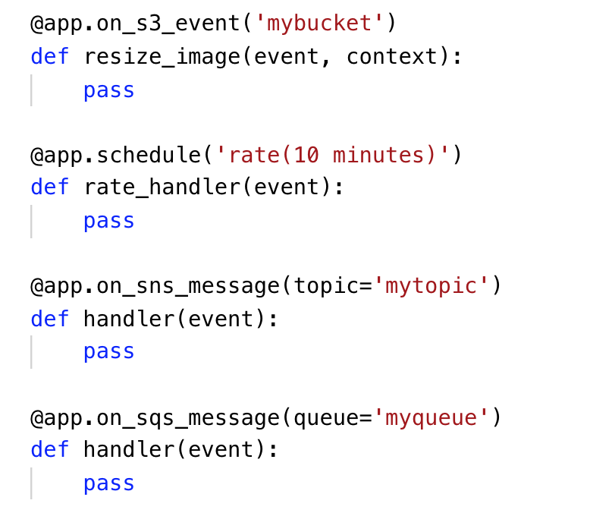
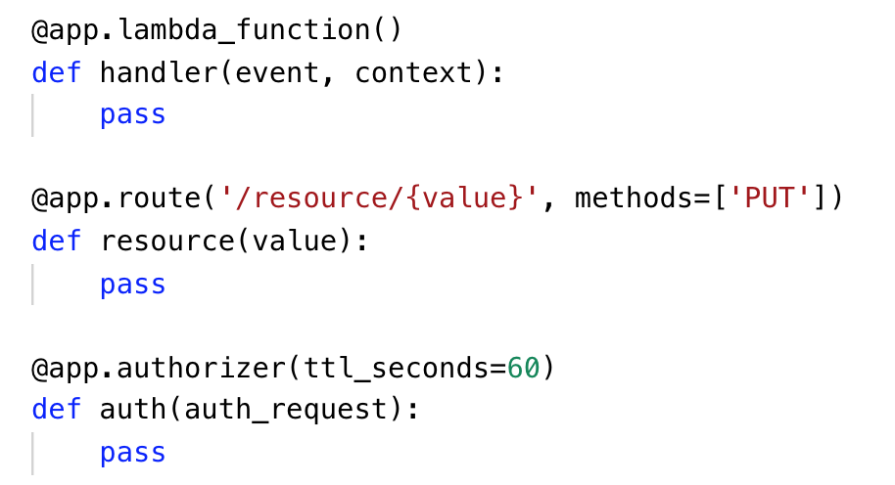
Other Chalice Decorators

Slide 108
Serverless Computing
Serverless Architecture
Serverless Application with Python

Slide 109
Resources
Introduction to AWS Lambda and Chalice
GitHub for Chalice
Serverless Framework for AWS
AWS re:Invent 2018: A Serverless Journey: AWS Lambda Under the Hood

Slide 112






About AWS Architecture Icons
Architecture diagrams are a great way to communicate your design, deployment and topology. In this deck, you will find an official collection of AWS product icons, resources, and other tools to help you build customer-focused and consistent AWS Architecture diagrams.
Customers and partners are permitted by AWS to use the icons to create architecture diagrams. They are designed to be simple so that you can easily incorporate them in your diagrams and put them in your whitepapers, presentations, datasheets, posters, or any technical material you like.
AWS Cloud
Availability Zone 1
Availability Zone 2
VPC
NAT Gateway
Amazon EC2 Auto Scaling
NAT Gateway
Auto Scaling group
Instance
Instance
Auto Scaling group
Instance
Instance

Slide 113
Before you begin:
1
2
3
Check for the
latest deck update
Read the guidelines
When in doubt,
see the examples
For specific element guidance and best practices, see the guidelines.
Download the
latest deck from the
AWS Architecture Center
For completed diagrams, jump to the example pages for completed diagrams. If you’re having trouble with a particular layout or object, use these as a blueprint.

Slide 114
System
An all-up look at the diagram system

Slide 115




System elements
AWS Cloud
Groups
Arrows
Product icons
Show the connection between multiple products or resources
Describe a flow of information or connect different parts of a diagram
Represents an AWS product or service
Resource icons
General resource icons
Represents an AWS product resource
Apply to multiple products or categories

Slide 116
System elements
Group icon
AWS Cloud
Layered groups
Availability Zone 1
Availability Zone 2
VPC
Product icon
NAT Gateway
Amazon EC2 Auto Scaling
NAT Gateway
Auto Scaling group
Instance
Instance
Auto Scaling group
Resource icon
Instance
Instance

Slide 117
Guidelines
Diagram and element guidance

Slide 118
Building a diagram
Choose your deck style The architecture deck is available for both light and dark backgrounds. Determine which best fits your need – light backgrounds tend to be used on the web, whereas dark backgrounds are used for in-person presentations or slide decks.
Start with the structure Locate the groups to use for the underlying structure of your diagram.
Add product and resource icons Navigate to the category of your desired product icon or resource, or use the search capability to locate it. Then, copy and paste it into your diagram.
Add other steps Does your diagram include external users or devices? Use resources to add depth or context to your diagram.
Connect the steps Use the preset arrows to connect your steps and describe a workflow.

Slide 119
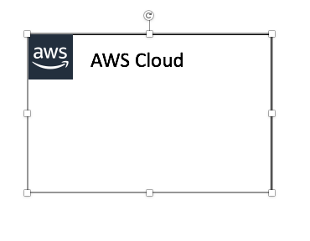

Groups
Each group consists of an icon and a label. Colors and lines help differentiate groups to make it easier for the user to read a diagram at a glance. Some groups cross multiple other groups, such as Auto Scaling, whereas others are meant to layer inside one another, such as VPC and subnets.
Resizing groups
Layering groups
Use the bottom right corner of a group box to stretch or collapse to your desired size.
When you have groups within groups, each inner group should have about 0.05” buffer on each side.
DO:
Hold Shift down while resizing an icon to maintain a square
Use a generic group type if the presets do not suit your needs
VPC
Public subnet
DON’T:
Create new group icons

Slide 120



Icons
Primary product and resource icons are designed to be used on both dark and light backgrounds. Alternate product icons are specific to a background type. All icons may be renamed to better fit your use case.
Resizing icons
Using the alternate product icon
All icons in this deck are SVGs, allowing them to be scaled up or down depending on the diagram. To preserve icon integrity, be sure to hold down Shift while resizing.
DO:
In some complex diagrams, it may be less visually distracting to use the alternate “light-bg” product icons. These are built with a solid color background instead of a gradient and may be used interchangeably at your discretion.
Hold Shift down while resizing
Change the resource icon text color when using a dark background
Use the alternate light-bg product icon when appropriate
DON’T:
Crop product icons
Flip or rotate icons
Change icon shapes
Amazon-Lex.svg
Amazon-Lex_light-bg.svg

Slide 121
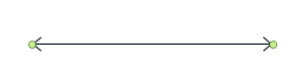
Arrows
Use arrows or lines to connect parts of a diagram or to show a workflow.
Use preset arrows
Create new arrows
Copy the preset arrows into your diagram to maintain correct formatting. To edit, click on the arrow, hold down Shift.
Preset arrows use the “Open Arrow” in Size 4.
DO:
Use the preset arrows provided in the Elements section
Use straight lines and right angles to connect objects
Default Arrow
+ Open Arrow
+ Size 4
When in doubt, use the default
DON’T:
Hold Shift
If the arrow shape you need is not available in the sample arrows, go ahead and use the default arrows.
Create diagonal lines
Use anything beside preset or default arrows

Slide 122

Text boxes
Product and icon names are separated from the icon itself to allow for adjustment or abbreviation. You may change the size or color of the text, or use the short form of the product name if necessary.
Name wrapping and line breaks
AWS product names should fit on one or two lines. AWS or Amazon should always be accompanied by the product name. Lines should never break mid-word.
DO:
Modify color or text size if necessary
Break a line after the second word in the product name
Amazon Elasticsearch Service
Amazon
Elasticsearch Service
Amazon
Elastic-
search Service
DON’T:
Amazon should be on the same line as the first word in the product name
Lines should never break mid-word
Should fit on 2 lines max
Use short forms without first mentioning the full product name
Duplicate short forms for different products, i.e., ELB for Elastic Beanstalk and Elastic Load Balancing
Break a line in the middle of a word
Short forms
If you are using a product multiple times in a diagram, you may use the short form or abbreviation instead of the full product name to save space.

Slide 123
Elements
Groups, arrows, resource icons, and product icons to use when building your diagram

Slide 124
Icon categories
Click a category to jump to slide (must be in Presentation mode)
General Resources
Analytics
Application Integration
AR & VR
AWS Cost Management
Blockchain
Business Applications
Compute
Customer Engagement
Database
Developer Tools
End User Computing
Game Tech
Internet of Things
Machine Learning
Management & Governance
Media Services
Migration & Transfer
Mobile
Networking & Content Delivery
Robotics
Satellite
Security, Identity, & Compliance
Storage

Slide 125
General resources

Slide 126








Groups
1/3
AWS Cloud
AWS Cloud
Region
Availability Zone
Security group
Auto Scaling group
VPC
Private subnet
Public subnet
Server contents
Corporate data center
Elastic Beanstalk container
EC2 instance contents
Spot Fleet
AWS Step Functions workflow
Generic group
Generic group

Slide 127
Arrows
2/3

Slide 128

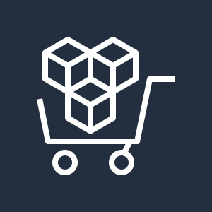

















General icons
3/3
AWS Marketplace
AWS Marketplace
Client
Disk
Forums
Generic database
Internet
Internet alt1
Internet alt2
Mobile client
Multimedia
Office building
SAML token
SSL padlock
Tape storage
Traditional server
User
Users
Toolkit
SDK

Slide 129


Analytics

Slide 130










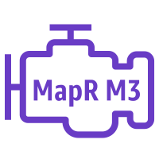


Analytics
1/4
Amazon CloudSearch
Amazon EMR
Amazon Kinesis
Amazon CloudSearch
Amazon EMR
Amazon Kinesis
Search documents
HDFS cluster
Cluster
EMR engine
EMR engine MapR M3
EMR engine MapR M5
EMR engine MapR M7

Slide 131








Analytics
2/4
Amazon Kinesis
Video Streams
Amazon Kinesis
Data Streams
Amazon Kinesis
Data Firehose
Amazon Kinesis
Data Analytics
Amazon Kinesis
Video Streams
Amazon Kinesis
Data Streams
Amazon Kinesis
Data Firehose
Amazon Kinesis
Data Analytics

Slide 132











Analytics
3/4
AWS Glue
Amazon Athena
Amazon Elasticsearch Service
Amazon Redshift
AWS Glue
Amazon Athena
Amazon Elasticsearch Service
Amazon Redshift
Crawler
Dense compute node
Data Catalog
Dense storage node

Slide 133








Analytics
4/4
Amazon QuickSight
AWS Lake Formation
AWS Data Pipeline
Amazon Managed Streaming for Kafka
Amazon QuickSight
AWS Lake Formation
AWS Data Pipeline
Amazon Managed Streaming for Kafka

Slide 134


Application Integration

Slide 135













Application Integration
1/2
Amazon Simple Notification Service
Amazon Simple Queue Service
Amazon MQ
AWS AppSync
Amazon Simple Notification Service
Amazon Simple Queue Service
Amazon MQ
AWS AppSync
Email notification
Message
HTTP notification
Queue
Topic

Slide 136


Application Integration
2/2
AWS Step Functions
AWS Step Functions

Slide 137


AR & VR

Slide 138


AR & VR
1/1
Amazon Sumerian
Amazon Sumerian

Slide 139


AWS Cost Management

Slide 140








AWS Cost Management
1/1
AWS Budgets
AWS Cost and Usage Report
AWS Cost Explorer
Reserved Instance Reporting
AWS Budgets
AWS Cost and Usage Report
AWS Cost Explorer
Reserved Instance Reporting

Slide 141


Blockchain

Slide 142




Blockchain
1/1
Amazon Managed Blockchain
Amazon Quantum Ledger Database (QLDB)
Amazon Managed Blockchain
Amazon Quantum Ledger Database (QLDB)

Slide 143


Business Applications

Slide 144






Business Applications
1/1
Alexa for Business
Amazon Chime
Amazon WorkMail
Alexa for Business
Amazon Chime
Amazon WorkMail

Slide 145


Compute

Slide 146































Compute
1/5
AMI
Auto Scaling
Elastic IP Address
Rescue
Amazon EC2
Instance
A1 instance
M4 instance
R5a instance
z1d instance
H1 instance
Amazon EC2
Instances
T3 instance
C5 instance
R4 instance
P3 instance
I3 instance
Spot instance
T2 instance
C5n instance
X1e instance
P2 instance
D2 instance
Instance with CloudWatch
M5 instance
C4 instance
X1 instance
G3 instance
DB on instance
M5a instance
R5 instance
High Memory instance
F1 instance

Slide 147












Compute
2/5
Amazon EC2 Auto Scaling
Amazon Elastic Container Registry
Amazon Elastic Container Service
Amazon EC2 Auto Scaling
Amazon Elastic Container Registry
Amazon Elastic Container Service
Registry
Container 1
Container 2
Container 3
Image
Task
Service

Slide 148










Compute
3/5
AWS Elastic Beanstalk
AWS Lambda
Amazon Elastic Container Service for Kubernetes
Amazon Lightsail
AWS Elastic Beanstalk
AWS Lambda
Amazon Elastic Container Service for Kubernetes
Amazon Lightsail
Deployment
Lambda function
Application

Slide 149








Compute
4/5
AWS Batch
AWS Fargate
AWS Outposts
AWS Serverless Application Repository
AWS Batch
AWS Fargate
AWS Outposts
AWS Serverless Application Repository

Slide 150


Compute
5/5
VMware Cloud on AWS
VMware Cloud on AWS

Slide 151


Customer Engagement

Slide 152







Customer Engagement
1/1
Amazon Connect
Amazon Pinpoint
Amazon Simple Email Service (SES)
Amazon Connect
Amazon Pinpoint
Amazon Simple Email Service (SES)
Email

Slide 153


Database

Slide 154
















Database
1/3
Amazon Aurora
Amazon DocumentDB (with MongoDB compatibility)
Amazon DynamoDB
Amazon ElastiCache
Amazon Aurora
Amazon DocumentDB (with MongoDB compatibility)
Amazon DynamoDB
Amazon ElastiCache
Attribute
Items
Cache node
Item
Table
ElastiCache for Redis
ElastiCache for Memcached
Attributes
Global secondary index

Slide 155











Database
2/3
Amazon Redshift
AWS Database Migration Service
Amazon Neptune
Amazon Quantum Ledger Database (QLDB)
Amazon Redshift
AWS Database Migration Service
Amazon Neptune
Amazon Quantum Ledger Database (QLDB)
Dense compute node
Database migration workflow/job
Dense storage node

Slide 156






Database
3/3
Amazon RDS
Amazon RDS on VMware
Amazon Timestream
Amazon RDS
Amazon RDS on VMware
Amazon Timestream

Slide 157


Developer Tools

Slide 158








Developer Tools
1/3
AWS Cloud9
AWS CodeBuild
AWS CodeCommit
AWS CodeDeploy
AWS Cloud9
AWS CodeBuild
AWS CodeCommit
AWS CodeDeploy

Slide 159








Developer Tools
2/3
AWS CodePipeline
AWS CodeStar
AWS Command Line Interface
AWS Tools and SDKs
AWS CodePipeline
AWS CodeStar
AWS Command Line Interface
AWS Tools and SDKs

Slide 160


Developer Tools
3/3
AWS X-Ray
AWS X-Ray

Slide 161


End User Computing

Slide 162

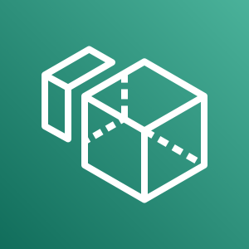



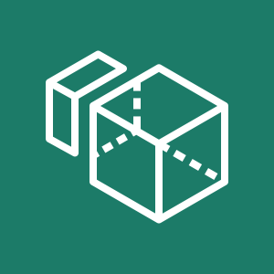


End User Computing
1/1
Amazon AppStream 2.0
Amazon WorkSpaces
Amazon WorkLink
Amazon WorkDocs
Amazon AppStream 2.0
Amazon WorkSpaces
Amazon WorkLink
Amazon WorkDocs

Slide 163


Game Tech

Slide 164


Game Tech
1/1
Amazon GameLift
Amazon GameLift

Slide 165


Internet of Things

Slide 166













Internet of Things
1/4
Amazon FreeRTOS
AWS IoT 1-Click
AWS IoT Analytics
AWS IoT Button
Amazon FreeRTOS
AWS IoT 1-Click
AWS IoT Analytics
AWS IoT Button
Channel
Data set
Pipeline
Notebook
Data store

Slide 167








Internet of Things
2/4
AWS IoT Core
AWS IoT Device Defender
AWS IoT Device Management
AWS IoT Events
AWS IoT Core
AWS IoT Device Defender
AWS IoT Device Management
AWS IoT Events

Slide 168






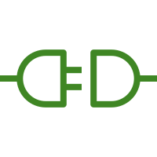
Internet of Things
3/4
AWS IoT Greengrass
AWS IoT SiteWise
AWS IoT Things Graph
AWS IoT Greengrass
AWS IoT SiteWise
AWS IoT Things Graph
Connector

Slide 169










































Internet of Things
4/4
IoT action
IoT actuator
IoT certificate
IoT desired state
IoT hardware board
IoT HTTP protocol
IoT HTTP/2 protocol
IoT MQTT protocol
IoT policy
IoT reported state
IoT rule
IoT sensor
Device gateway
IoT servo
IoT
shadow
IoT simulator
IoT topic
Alexa skill
Alexa voice service
Alexa enabled device
Echo
Fire TV
Fire TV stick
Lambda function
Over-the-air update
IoT thing bank
IoT thing bicycle
IoT thing camera
IoT thing car
IoT thing cart
IoT thing coffee pot
IoT thing door lock
IoT thing factory
IoT thing generic
IoT thing house
IoT thing lightbulb
IoT thing medical emergency
IoT thing police emergency
IoT thing thermostat
IoT thing travel
IoT thing utility
IoT thing windfarm

Slide 170


Machine Learning

Slide 171






Machine Learning
1/5
Amazon Comprehend
Amazon Elastic Inference
Amazon Forecast
Amazon Lex
Amazon Comprehend
Amazon Elastic Inference
Amazon Forecast
Amazon Lex

Slide 172













Machine Learning
2/5
Amazon Personalize
Amazon Polly
Amazon Rekognition
Amazon SageMaker
Amazon Personalize
Amazon Polly
Amazon Rekognition
Amazon SageMaker
Rekognition image
Notebook
Rekognition video
Model
Train

Slide 173








Machine Learning
3/5
Amazon SageMaker Ground Truth
Amazon Textract
Amazon Transcribe
Amazon Translate
Amazon SageMaker Ground Truth
Amazon Textract
Amazon Transcribe
Amazon Translate

Slide 174








Machine Learning
4/5
Apache MXNet on AWS
AWS Deep Learning AMIs
AWS DeepLens
AWS DeepRacer
Apache MXNet on AWS
AWS Deep Learning AMIs
AWS DeepLens
AWS DeepRacer

Slide 175


Machine Learning
5/5
TensorFlow on AWS
AWS Deep Learning Containers
TensorFlow on AWS
AWS Deep Learning Containers

Slide 176


Management & Governance

Slide 177















Management & Governance
1/5
Amazon CloudWatch
AWS Auto Scaling
AWS CloudFormation
AWS CloudTrail
Amazon CloudWatch
AWS Auto Scaling
AWS CloudFormation
AWS CloudTrail
Alarm
Rule
Change set
Stack
Event
(event-based)
Event (time-based)
Template

Slide 178








Management & Governance
2/5
AWS Command Line Interface
AWS Config
AWS License Manager
AWS Managed Services
AWS Command Line Interface
AWS Config
AWS License Manager
AWS Managed Services

Slide 179














Management & Governance
3/5
AWS Management Console
AWS OpsWorks
AWS Personal Health Dashboard
AWS Management Console
AWS OpsWorks
AWS Personal Health Dashboard
Apps
Instances
Monitoring
Permissions
Deployments
Layers
Resources
Stack2

Slide 180












Management & Governance
4/5
AWS Service Catalog
AWS Systems Manager
AWS Service Catalog
AWS Systems Manager
Automation
Documents
Patch Manager
Parameter Store
Inventory
Maintenance Windows
State Manager
Run Command

Slide 181











Management & Governance
5/5
AWS Trusted Advisor
AWS Well-Architected Tool
AWS Control Tower
AWS Trusted Advisor
AWS Well-Architected Tool
AWS Control Tower
Checklist cost
Checklist performance
Checklist security
Checklist fault tolerant
Checklist

Slide 182


Media Services

Slide 183








Media Services
1/2
Amazon Elastic Transcoder
Amazon Kinesis
Video Streams
AWS Elemental MediaConnect
AWS Elemental MediaLive
Amazon Elastic Transcoder
Amazon Kinesis
Video Streams
AWS Elemental MediaConnect
AWS Elemental MediaLive

Slide 184








Media Services
2/2
AWS Elemental MediaConvert
AWS Elemental MediaPackage
AWS Elemental MediaStore
AWS Elemental MediaTailor
AWS Elemental MediaConvert
AWS Elemental MediaPackage
AWS Elemental MediaStore
AWS Elemental MediaTailor

Slide 185


Migration and Transfer

Slide 186









Migration and Transfer
1/2
AWS Application Discovery Service
AWS Database Migration Service
AWS DataSync
AWS Migration Hub
AWS Application Discovery Service
AWS Database Migration Service
AWS DataSync
AWS Migration Hub
Agent

Slide 187








Migration and Transfer
2/2
AWS Server Migration Service
AWS Transfer for SFTP
AWS Snowball
AWS Snowball Edge
AWS Server Migration Service
AWS Transfer for SFTP
AWS Snowball
AWS Snowball Edge

Slide 188
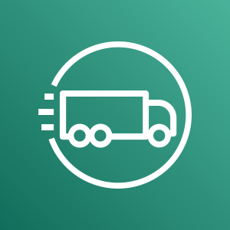
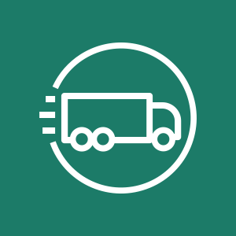
Migration and Transfer
2/2
AWS Snowmobile
AWS Snowmobile

Slide 189


Mobile

Slide 190









Mobile
1/2
Amazon API Gateway
Amazon Pinpoint
AWS Amplify
AWS AppSync
Amazon API Gateway
Amazon Pinpoint
AWS Amplify
AWS AppSync
Endpoint

Slide 191


Mobile
2/2
AWS Device Farm
AWS Device Farm

Slide 192


Networking & Content Delivery

Slide 193











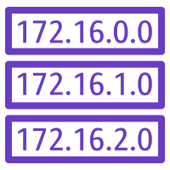

Networking & Content Delivery
1/4
Amazon API Gateway
Amazon CloudFront
Amazon Route 53
AWS PrivateLink
Amazon API Gateway
Amazon CloudFront
Amazon Route 53
AWS PrivateLink
Endpoint
Download distribution
Hosted zone
Edge location
Route table
Streaming distribution

Slide 194













Networking & Content Delivery
2/4
Amazon VPC
Amazon VPC
Customer gateway
Elastic Network Adapter
Endpoints
Internet gateway
Router
VPN gateway
Elastic network interface
NAT gateway
Flow logs
Network access control list
VPN connection
Peering

Slide 195








Networking & Content Delivery
3/4
AWS App Mesh
AWS Cloud Map
AWS Direct Connect
AWS Global Accelerator
AWS App Mesh
AWS Cloud Map
AWS Direct Connect
AWS Global Accelerator

Slide 196











Networking & Content Delivery
4/4
AWS Transit Gateway
AWS Client VPN
AWS Site-to-Site VPN
Elastic Load Balancing
AWS Transit Gateway
AWS Client VPN
AWS Site-to-Site VPN
Elastic Load Balancing
Application Load Balancer
Classic Load Balancer
Network Load Balancer

Slide 197


Robotics

Slide 198






Robotics
1/1
AWS RoboMaker
AWS RoboMaker
Fleet management
Development environment
Cloud extensions ROS
Simulation

Slide 199


Satellite

Slide 200


Satellite
1/1
AWS Ground Station
AWS Ground Station

Slide 201


Security, Identity, & Compliance

Slide 202









Security, Identity and Compliance
1/5
Amazon Cloud Directory
Amazon Cognito
Amazon GuardDuty
Amazon Inspector
Amazon Cloud Directory
Amazon Cognito
Amazon GuardDuty
Amazon Inspector
Agent

Slide 203









Security, Identity and Compliance
2/5
Amazon Macie
AWS Artifact
AWS Certificate Manager
AWS CloudHSM
Amazon Macie
AWS Artifact
AWS Certificate Manager
AWS CloudHSM
Certificate Manager

Slide 204
















Security, Identity and Compliance
3/5
AWS Directory Service
AWS Firewall Manager
AWS Identity and Access Management (IAM)
AWS Directory Service
AWS Firewall Manager
AWS Identity and Access Management (IAM)
Add-on
MFA token
Encrypted data
Long-term security credential
AWS STS
Permissions
Data encryption key
Temporary security credential
AWS STS (alternate)
Role

Slide 205









Security, Identity and Compliance
4/5
AWS Key Management Service
AWS Secrets Manager
AWS Security Hub
AWS Shield
AWS Key Management Service
AWS Secrets Manager
AWS Security Hub
AWS Shield
AWS Shield Advanced

Slide 206





Security, Identity and Compliance
5/5
AWS Single Sign-On
AWS WAF
AWS Single Sign-On
AWS WAF
Filtering rule

Slide 207


Storage

Slide 208











Storage
1/3
Amazon Elastic Block Store (EBS)
Amazon Elastic File System
Amazon FSx
Amazon FSx for Lustre
Amazon Elastic Block Store (EBS)
Amazon Elastic File System
Amazon FSx
Amazon FSx for Lustre
Snapshot
File system
Volume

Slide 209













Storage
2/3
Amazon FSx for Windows File Server
Amazon Simple Storage Service (S3)
Amazon S3 Glacier
AWS Snowball
Amazon FSx for Windows File Server
Amazon Simple Storage Service (S3)
Amazon S3 Glacier
AWS Snowball
Object
Bucket
Vault
Archive
Snowball import-export
Bucket with objects

Slide 210

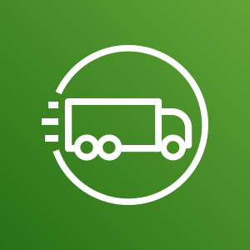



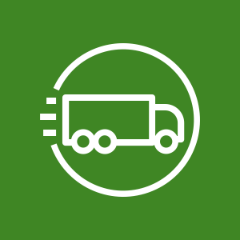





Storage
3/3
AWS Snowball Edge
AWS Snowmobile
AWS Backup
AWS Storage Gateway
AWS Snowball Edge
AWS Snowmobile
AWS Backup
AWS Storage Gateway
Non-cached volume
Cached volume
Virtual tape library

Slide 211
Examples
The system in action

Slide 212
Example:
Git to S3 Webhooks
AWS Cloud
Amazon S3 SSH Key bucket
Git push
Third-party Git repository
Git webhook
Git users
AWS KMS key
AWS Lambda
AWS Lambda
Amazon S3 output bucket

Slide 213
Example:
Chef Automate Architecture on AWS
AWS Cloud
Availability Zone
VPC
Internet gateway
Public subnet
Knife is used to upload cookbooks
Knife is used to bootstrap and communicate with nodes
Chef-client processes run-list
1
Chef Automate
3
2
Chef workstation (local Chef repo)
Chef node
10.0.0.0/19
10.0.0.0/16

